Slide 1
DIATECH Market & Sales Deck
Jchytech 13-1-26

Slide 2
Market Context
Strong increase in Pet dermatology consultations (+8–12%/year)
Rising pet ownership across EU
Owners demand rapid answers; less tolerance for guesswork
Insurance coverage expanding in FR/IT/ES
Clinics shift to rapid diagnostics for margin optimisation

Slide 3
Data Allergies
Dogs: 12–18% prevalence
Cats: 10–14% prevalence
Less than 25% of symptomatic cases tested
Symptoms: pruritus, skin lesions, respiratory signs

Slide 4
Data Viral Diseases
Parvo, Distemper, Corona in dogs
Panleukopenia, Calicivirus in cats
Strong driver for rapid in-clinic testing

Slide 5
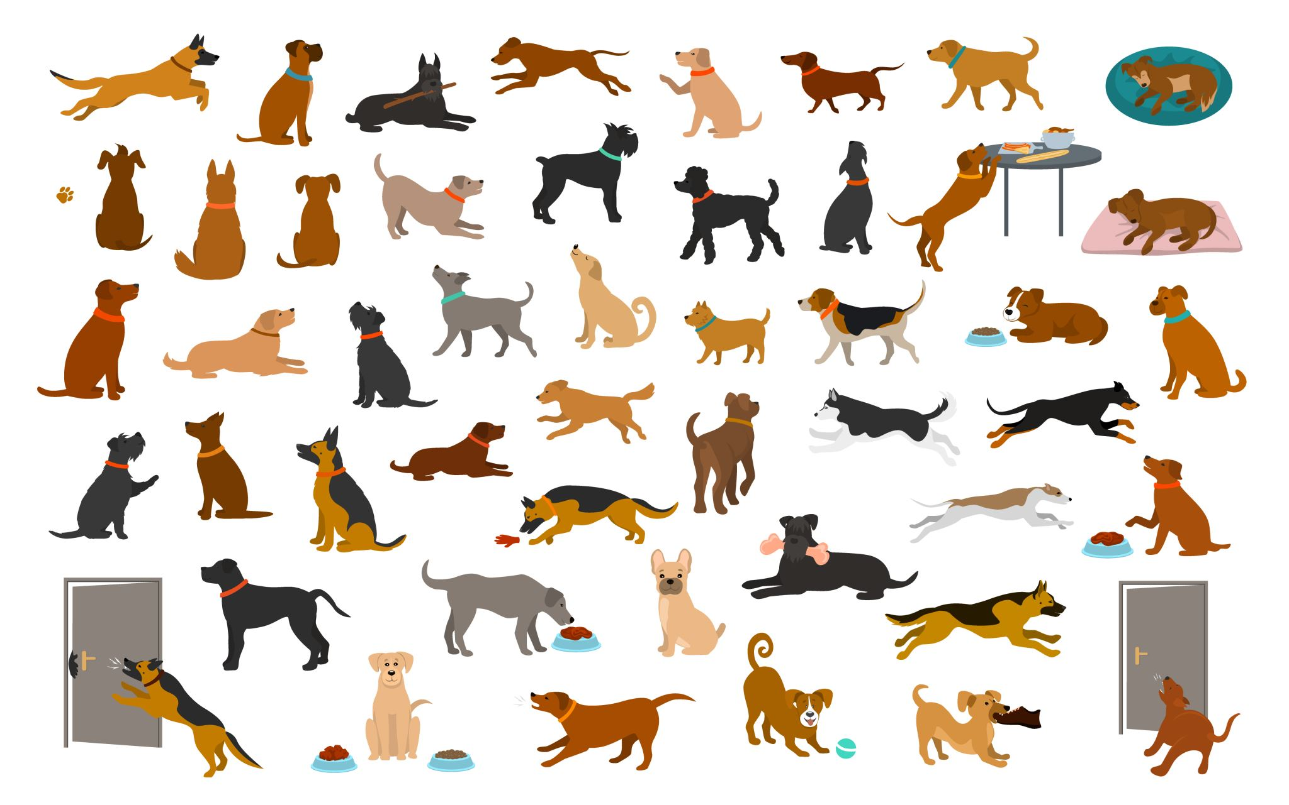
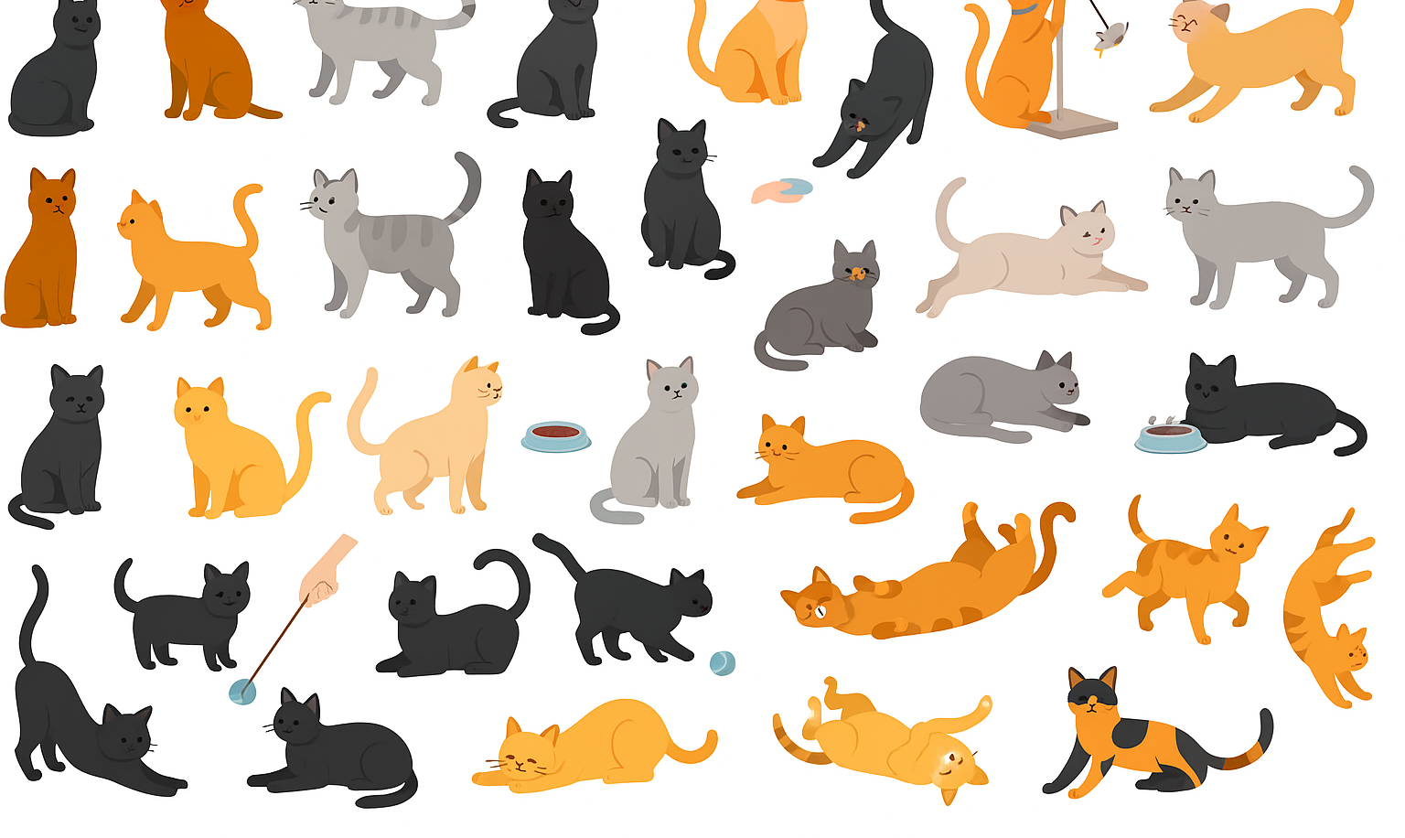
Pet Allergy Diagnostics Market Data

Slide 6
Pet Allergy Diagnostics Market
Global: $370M (2025) → $714M (2035)
EU is fastest-growing region
Diagnostics driven by insurance, dermatology and vet margins

Slide 7
Pet Allergy Diagnostics Market
Global: $370M (2025) → $714M (2035)
EU is fastest-growing region
Diagnostics driven by insurance, dermatology and vet margins

Slide 8
Segmentation
By test type: LFIA, ELISA, Dot Arrays
By channel: clinics, specialists, distributors, D2C
By species: dogs (~75%), cats (~25%)

Slide 9
Competitive Landscape
Lab IgE panels: detailed but slow & expensive
Existing rapid tests: inconsistent quality
Specialists: limited throughput
DIATECH: Fast + Accurate + Affordable + Scalable

Slide 10
Pricing Benchmarks
Lab IgE panels: €85–150
Rapid tests: €28–45
Dot arrays: €120–180
Proposal DIATECH Rapid Test: €35–39
Proposal DIATECH Array: €120–150

Slide 11
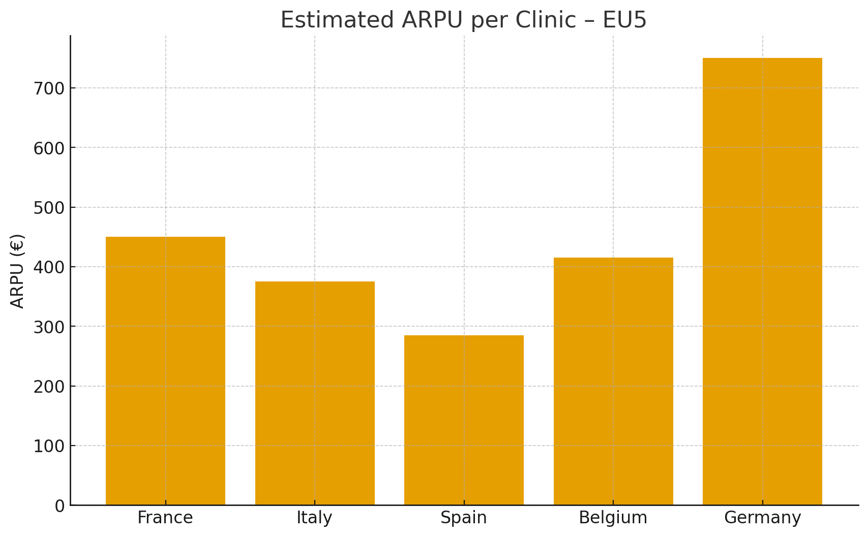
Market by countries

Slide 12
EU5 Prioritisation
France: High potential / Medium complexity
Italy: High potential / Medium complexity
Spain: Medium potential / Low complexity
Germany: High potential / High complexity
Belgium: Low potential / Easy entry

Slide 13
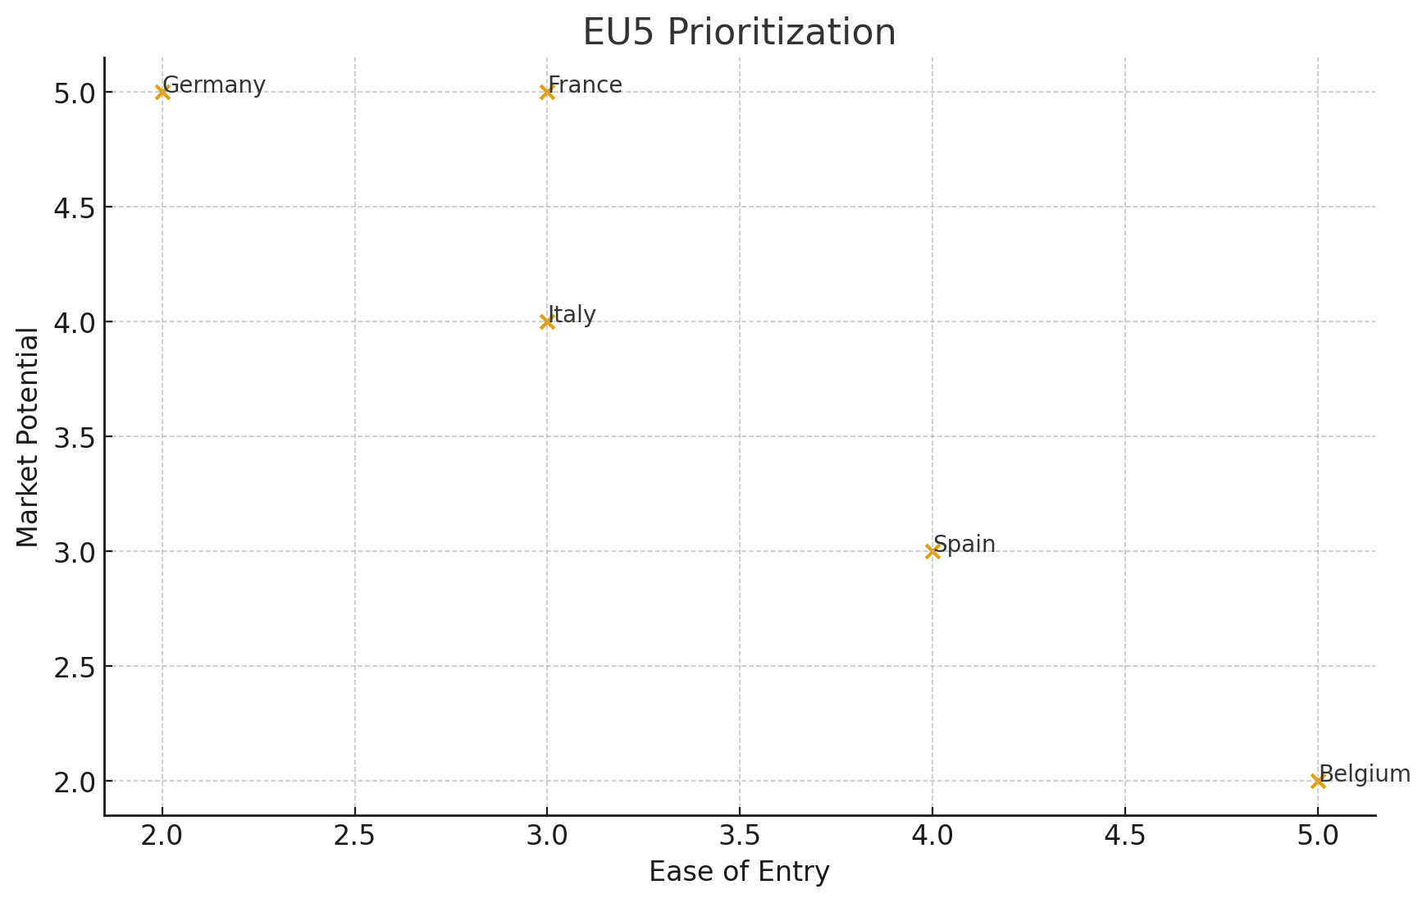
EU5 Prioritisation
Average Revenue of Vet Per Pet Owner
ARPU

Slide 14
France – Overview
~7,200 clinics
High dermatology caseload
Strong distributors: Centravet, Alcyon, Coveto

Slide 15

France – Overview

Slide 16
France – Market Potential
230k–290k tests annually
High willingness to adopt rapid testing

Slide 17
France – Competitive
Lab panels strong but costly
Rapid tests: low CE compliance
Specialists overloaded → clinics need tools

Slide 18
France – Go-to-Market
Phase 1
KOL network AFVAC Veterinary association including Belgium
Phase 2
Distributors onboarding
Phase 3
Direct-to-clinic activation
Phase 4
Upsell arrays + reader

Slide 19

Italy – Overview
High dermatology culture
Key distributors: Agrisan, Virbac Italy

Slide 20

Spain – Overview
Price-sensitive but easy entry
Key distributors: Distrivet, Covetrus Iberia

Slide 21

Germany – Overview
Highest ARPU Average Revenue Per User
Strict regulations
Long-term strategic market

Slide 22

Belgium – Overview
Small market, easy entry
High distributor centralisation
High level KOL

Slide 23


Product Portfolio Rapid Test Readers Dot Array

Slide 24
Product Portfolio Rapid Test
10–15 minutes, high specificity
No equipment needed
Ideal for first-line allergy workflow

Slide 25
Product Portfolio – Reader
Standardises interpretation
Reduces variability
Valuable upsell
Data Networking and R&D value

Slide 26
Product Portfolio – Array
High-information differential mapping
Great for chronic or complex cases

Slide 27

Distribution Strategy EU5
FR: Centravet, Alcyon, Coveto
IT: Agrisan, Virbac Italy
ES: Distrivet, Covetrus
DE: Alvetra & Werfft
BE: Ecuphar, Cenvet

Slide 28
Marketing Strategy EU5
KOL programs FR + B
Veterinary congresses
Training webinars
Distributor activation kits

Slide 29
Sales Funnel & KPIs
Awareness → Trial → Repeat → Subscription
KPIs: CAC, reorder rate, usage per clinic

Slide 30
Operational Roadmap
Q1: Registration and B2B & distributors contacts
Production labelling and logistics
Reader adaptation process start
Q2: KOL activation for commercial trials
Q3: FR Sales rollout
Q4: FR Sales + Reader launch
Year 2:
Arrays & Reader scale-up
Product line increase trough partnerships
ES + D
Year 3:
Other countries
Fund raising

Slide 31
Regulatory Roadmap
CE-Veterinary IVD technical file
Import steps per country
Multilingual IFUs
If Sales success ISO9001 (Year 2 or 3 )

Slide 32
DIATECH Thank You
Jchytech 13-1-26

